Slide 1

Modeling IV

Slide 2
Introduction
Instructions
Download Tutorial 13 Zip
Unzip Folder
Required Packages
Open .Rmd File and Knit
library(tidyverse)
library(modelr)
library(purrr)
library(broom)

Slide 3
Discussion
Problems With Current Approach
Same Model For All Locations
Not All Locations Used in Train
Not All Locations Used in Test
Residuals Indicate that Model Can Be Improved
Not Helpful for Forecasting
Ambiguous Results: No Clear Winner

Slide 4
Part 1: Cross Validation by Location
Previously
Split Data in Train and Test
Train (28 Rivers)
Test (3 Rivers)
Purpose
Estimate Out-of-Sample Error
Pick Best Model Based on This Estimate
Combat Overfitting
Robustification
Goal: Find the Simplest Model that Adequately Predicts

Slide 5
Part 1: Cross Validation by Location
Current Issues
Decision on Final Model Heavily Influenced by the Test Data
Loss of Data in Model Fitting
Not Appropriate in Small Datasets
Cross Validation Idea
Split Data Into Many Groups
Each Group Acts as a Test Set
All Data is Used in Both Model Fitting and Model Testing
Help: Chapter 5 (ISLR)

Slide 6
Part 1: Cross Validation by Location
Tidyverse Concepts
Chapter 20 (R4DS)
List-Columns
Columns in Data Frames or Tibbles Can Be Lists
What this Means
Column of Tables
Column of Models
Column of Functions
Functions
nest(): Converts Rows of a Data Frame into a List
unnest(): What do You Think It Does?

Slide 7
Part 1: Cross Validation by Location
Run Chunk 1
Observe the Output
Column of Tibbles
Run Chunk 2
Imagine We Wanted to Split
Test: Data For Location 103
Train: All Remaining Data
Use of filter() and unnest()
First Glimpse -> 365 x 8
Second Glimpse -> 10,972 x 8

Slide 8
Part 1: Cross Validation by Location
Chunk 3
Run Each Line
What is Happening?
Use View() on DATA2 and Scan Through the Data
What do You Notice?
Chunk 4
Create a Loop that Repeats this Process for Each Location
Each Location Is a Test Set
Predictions Saved are All Out-of-Sample
Run Chunk 4 to Test Your Code

Slide 9
Part 1: Cross Validation by Location
Chunk 4 (Continued)
DATA2=DATA
DATA2$linpred=NA
for(k in unique(DATA2$L)){
TEST = NEST.DATA %>% filter(L==k) %>% unnest()
TRAIN = NEST.DATA %>% filter(L!=k) %>% unnest()
linmod=lm(W~dplyr::lag(A,1),data=TRAIN)
linmodpred=predict(linmod,newdata=TEST)
DATA2$linpred[which(DATA2$L==k)]=linmodpred
}

Slide 10
Part 1: Cross Validation by Location
Chunk 5
In Our Data, We Have:
Actual Water Temperatures
Out-of-Sample Predicted Water Temperatures
Create RMSE.func() With Two Arguments
actual= vector of actual water temperatures
predict=vector of predicted water temperatures
Use This Function on the Two Columns in DATA2 for RMSE
actual=W
predict=linpred

Slide 11
Part 1: Cross Validation by Location
Chunk 5 (Continued)
RMSE.func = function(actual,predict){
mse=mean((actual-predict)^2,na.rm=T)
rmse=sqrt(mse)
return(rmse)
}
RMSE.func(actual=DATA2$W,
predict=DATA2$linpred)

Slide 12
Intermission
Current
Using the Natural Grouping of Data for 31-Fold Cross Validation
Only Fit One Linear Model
Should Use Cross-Validation for Multiple Different Models and Compare Cross-Validated RMSE
Next
Randomly Assign Observations to K-Folds
Helpful Function: cross_kfold(k)

Slide 13
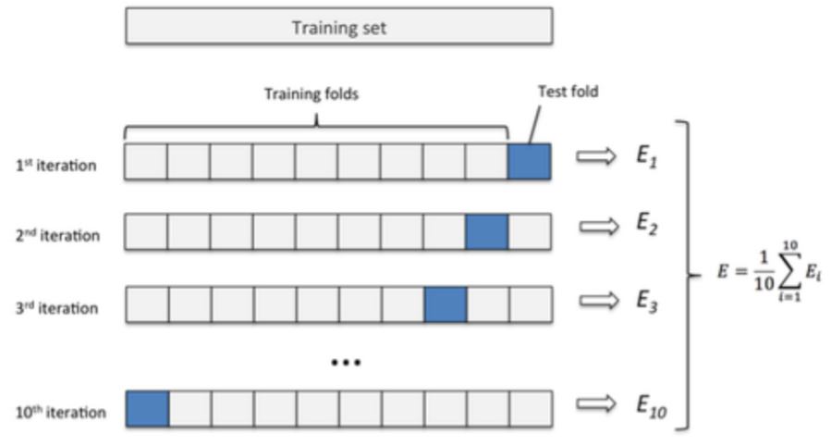
Part 2: K-Fold CV
Overview (K=10)
Randomly Split Observations Into K Groups
Each Fold Acts as a Test Set
If Each Fold Contains Approximately the Same # of Observations,

Slide 14
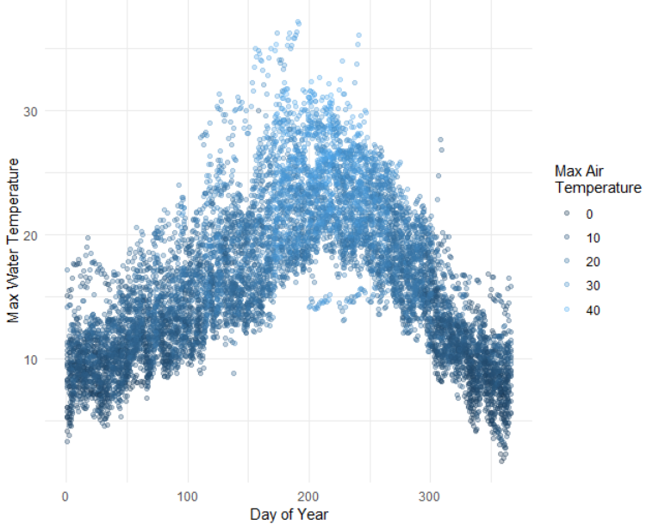
Part 2: K-Fold CV
Run Chunk 1
Variables (Julian Day)
Clear Non-Linear Relationship

Slide 15
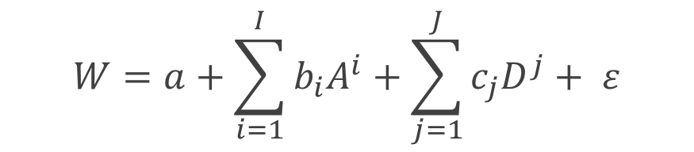
Part 2: K-Fold CV
General Polynomial Model
Perform K-Fold CV to Estimate Out-of-Sample RMSE for Choices of I=4 and J=3
Ultimate Goal is To Select Best I and J
$$W=a+\sum_{i=1}^{I}{b_{i}A^{i}}+\sum_{j=1}^{J}{c_{j}D^{j}}+ ε$$

Slide 16
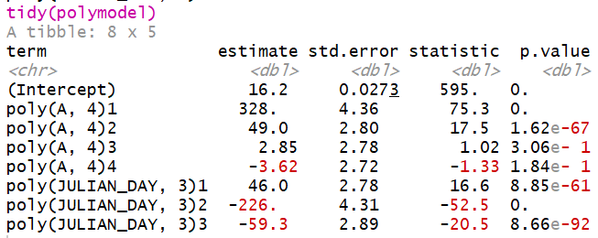
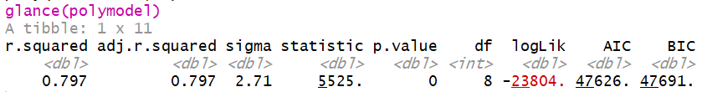
Part 2: K-Fold CV
Run Chunk 2
Fit Model with I=4 and J=3
Functions from broom Package
tidy()
glance()
Used For Previewing Data

Slide 17
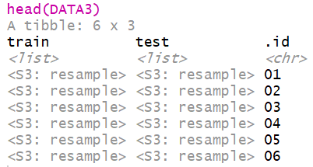
Part 2: K-Fold CV
Run Chunk 3
Divide Data into 10 Folds
Use crossv_kfold() Function
Variables are Lists of Train and Test Sets
For Each Row, We Want to Fit on Train and Predict on Test

Slide 18
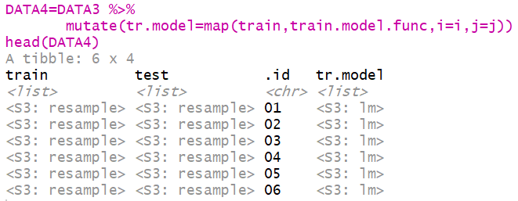
Part 2: K-Fold CV
Run Chunk 4
Create Function to Fit Models
Apply Function to All Train Sets Using purrr:map() Function
Functions from purrr Package
map() – Loop Over Train
map2() – Loop Over Fitted Models and Test

Slide 19
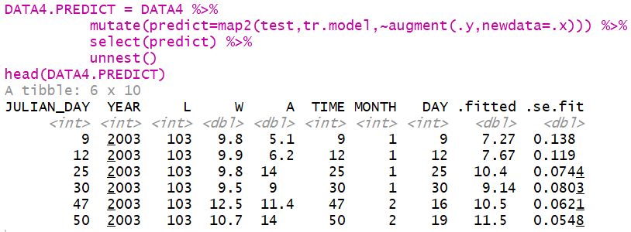
Part 2: K-Fold CV
Run Chunk 5
purrr:map2() Iterates Function Over Two Arguments
For Every Test Set and Trained Model, We Use augment() to Get Predictions
Next, Compare Fitted With Actual Using RMSE.func()

Slide 20
Look Ahead
What We Have Done
Specify I and J
Use 10-Fold Cross Validation to Estimate Out-of-Sample RMSE
How We Should Use This
Choose Max I and Max J
(Example: 10)
Initiate 10 x 10 Matrix of NA
Loop Through All i and j to Capture Out-of-Sample RMSE
Create a Tile Plot that Visualizes the RMSE for Each Combination of i and j
Choose Best i and j

Slide 21
Closing
Disperse and Make Reasonable Decisions

